Slide 1
FORGEAI – SINGLE PROMPT TO WEBSITE BUILDER
Full Name :
Akshay Gabrieal R
Full Name :
Prajwal Noel Pais
Registered Mail ID :
akshaygabriealr@gmail.com
Registered Mail ID :
prajwalnoel2005@gmail.com
College Name :
ST Joseph Engineering College
College Name :
ST Joseph Engineering College
Mob No. :
8123053082
Mob No. :
9482251882
IBM SkillsBuild platform mail ID :
akshaygabriealr@gmail.com
IBM SkillsBuild platform mail ID :
prajwalnoel2005@gmail.com
ForgeAI Engine & Frontend

Slide 2
Introduction
ForgeAI converts a one-line application idea into a runnable web project.
Locally-run application builder with a Next.js user interface and FastAPI gateway.
Uses specialized AI workers for planning, research, code generation, debugging and documentation.
Coordinates work through an in-process asynchronous DAG rather than a single linear generation step.
Stores local application data in SQLite (forgeai.db).

Slide 3
Problem Statement & Objective
Problem
Building production-style web applications manually requires repeated planning, coding, debugging, documentation and integration work.
Objective
Create a local AI application builder that decomposes an idea into tasks, generates a Next.js project, validates/repairs the build and produces documentation through coordinated workers.

Slide 4
System Architecture
Core components and local communication flow
Next.js Frontend
Port 3000
↓
FastAPI Gateway
Port 8000
↓
Async Worker DAG
Planner → Research → CodeGen → Debug → Docs
↓
SQLite
forgeai.db

Slide 5
Multi-Agent Task Orchestration
Planner Agent
Decomposes the request into a task DAG.
Research Agent
Collects design/UX references and supporting context.
CodeGen Agent
Generates the Next.js project/file tree.
Debug & Repair Agent
Builds in a sandbox and iteratively repairs errors.
Documentation Agent
Produces README and component documentation.

Slide 6
Local Execution & Testing
Launch frontend and backend together: python run_local.py
Windows alternative: start_dev.bat
Frontend Web App: localhost:3000
Backend Gateway API: localhost:8000
Swagger API Docs: localhost:8000/docs
Automated end-to-end test: python test_e2e_local.py

Slide 7
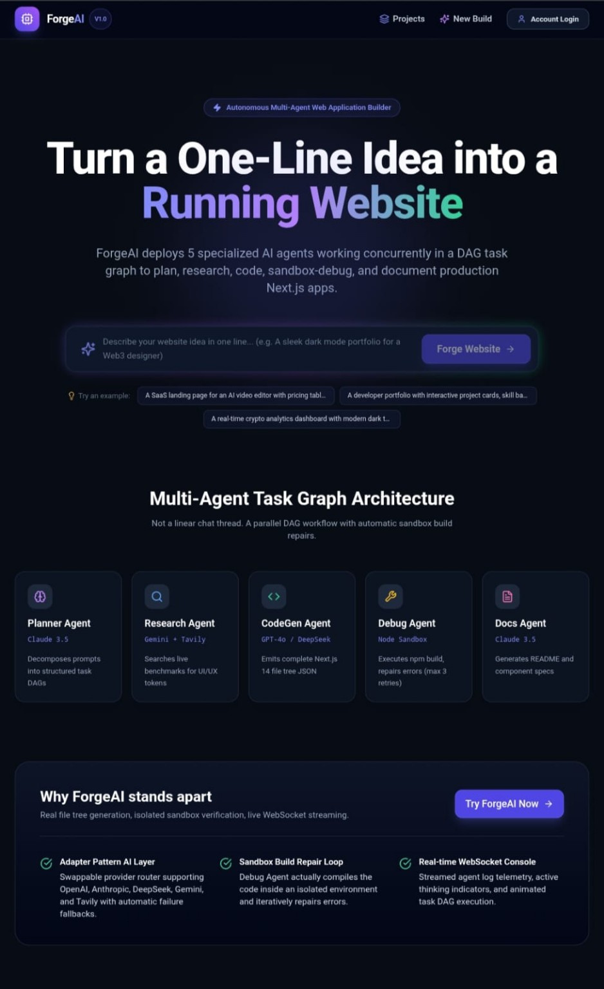
Results / Outcome
Actual ForgeAI frontend — application builder landing page

Slide 8
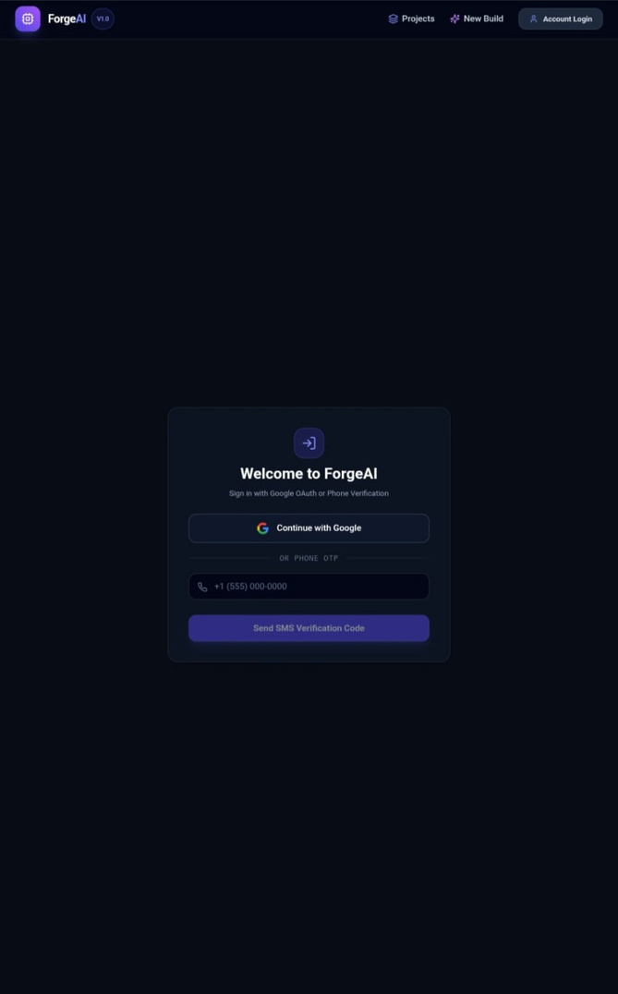
Running Application — Authentication Interface
Actual ForgeAI account login screen

Slide 9
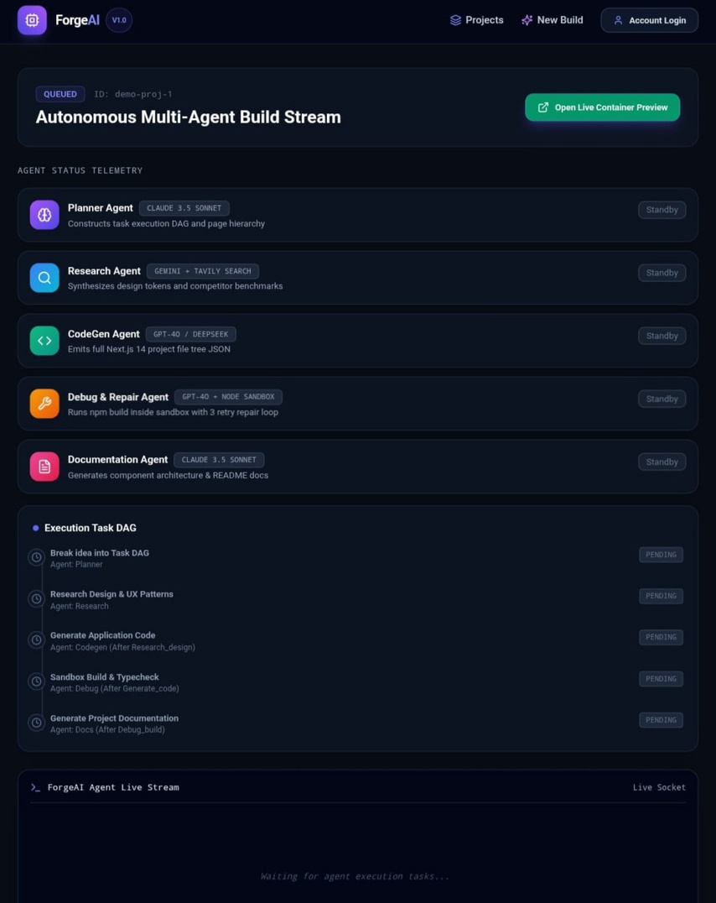
Build Execution Result
Actual autonomous multi-agent build stream and DAG telemetry
Agent telemetry
Planner, Research, CodeGen, Debug/Repair and Documentation workers are represented in the build stream.
Execution DAG
Tasks progress through idea decomposition, research, generation, sandbox build/typecheck and documentation.
Live stream
The interface provides a live socket area for execution feedback.

Slide 10
Repository Structure
backend/ — FastAPI gateway, orchestrator logic, worker scripts and API routing.
frontend/ — Next.js user interface.
docs/ — Project documentation.
infra/ — Infrastructure and local setup scripts.
forgeai.db — Local SQLite database.
Primary repository: Akshay23-source/App-Builder

Slide 11
Impact & Effectiveness
Faster application creation
Moves from a short natural-language idea toward a runnable web project through automated task decomposition and generation.
Automated repair workflow
The Debug & Repair worker is designed to validate builds in a sandbox and retry repairs rather than stopping at raw code generation.
Local-first architecture
Frontend, API gateway, orchestration and SQLite storage can run locally, keeping the development workflow self-contained.

Slide 12
Conclusion & Future Scope
ForgeAI combines a Next.js frontend, FastAPI gateway and asynchronous multi-agent DAG into a local application-building workflow.
The supplied application screenshots demonstrate the frontend, authentication interface and multi-agent build-stream experience.
Future work can expand deployment automation, observability, worker capabilities, provider integrations and production validation.
Additional measured E2E test output and a completed generated-site preview can be added as quantitative/final deployment evidence when available.

